Slide 1

Wildfly 8
Dima Ionut Daniel

Slide 2
Contents
What is Wildfly?
Architecture
Features
Installation
Configuration
Undertow Web Server
Domain Configuration
Clustering
Conclusions
Bibliography

Slide 3

What is Wildfly?
WildFly 8 is the direct continuation to the JBoss AS project.
WildFly 8 is free and open source, with support coming from the JBoss community.
The renaming of the community version of JBoss AS was done to reduce confusion between the open source
JBoss server, the JBoss community, and the JBoss Enterprise Application Platform (JBoss EAP).

Slide 4
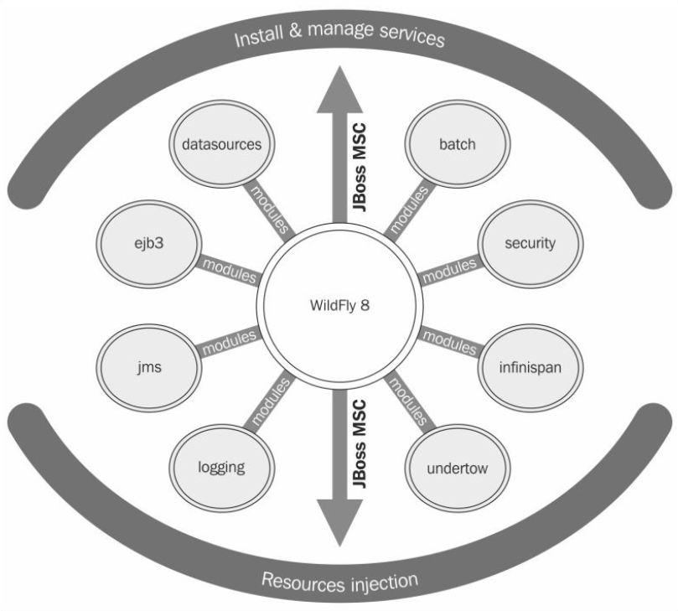
Architecture

Slide 5
Architecture (cont.)
WildFly’s kernel was redesigned in JBoss AS 7.
The kernel is based on two main projects:
JBoss Modules:
it handles class loading of resources in the container.
Modular Service Container (MSC):
it provides a way to install, uninstall, and manage services used by a container. MSC further enables resource injection into services and dependency management between services.

Slide 6
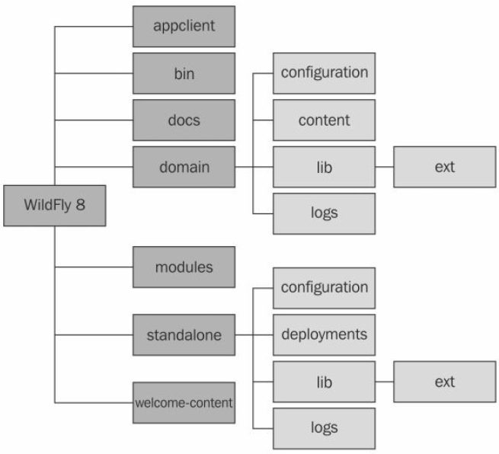
Architecture (cont.)

Slide 7
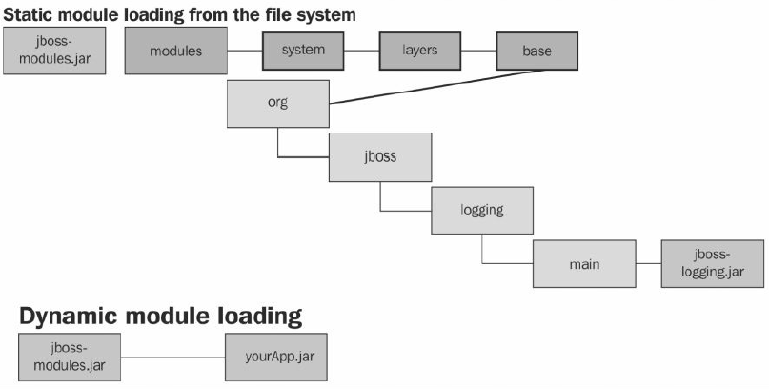
Architecture (cont.)
WildFly has two different types of modules:
Static modules
Dynamic modules

Slide 8
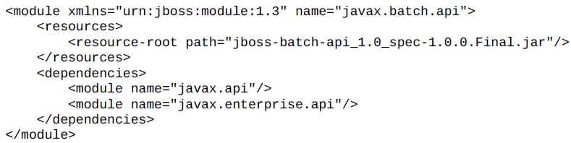
Architecture (cont.)
A module is really just a wrapper for a JAR file but treated by the application container as a module.
Each module can be treated as a pluggable unit.
Using a static module is the simplest way to load a module, and it’s used as the default module when starting up the application server.
Static modules are defined within the JBOSS_HOME/modules/system/layers/base directory.
The following example shows the contents of the javax.batch.api module.xml file:

Slide 9
Features
Java EE7 certification:
WildFly is a fully compliant Java EE enterprise server.
Using Undertow:
JBoss Web has been completely removed and replaced with Undertow.
Undertow is a cutting-edge web server that supports non-blocking and blocking handlers, web sockets, and asynchronous servlets
Port Reduction:
Wildfly uses 8080 and 9990 ports.
This has been achieved by multiplexing protocols over HTTP using the HTTP upgrade feature of Undertow.
Security Manager:
we can now configure per-deployment security permissions.

Slide 10
Features (cont.)
Logging:
We can view logfiles via the management interface, define custom formatters, and configure logging per-deployment.
Clustering:
Clustering in WildFly is heavily refactored and includes many new features, including web sessions, single sign-on, and mod_cluster support for Undertow.
There is also a new public clustering API and new @Stateful EJB caching implementation.
Command-line interface (CLI):
We have the ability to define an alias when connecting to a server, and the CLI GUI has additional functionality allowing you to explore any node in the tree.

Slide 11
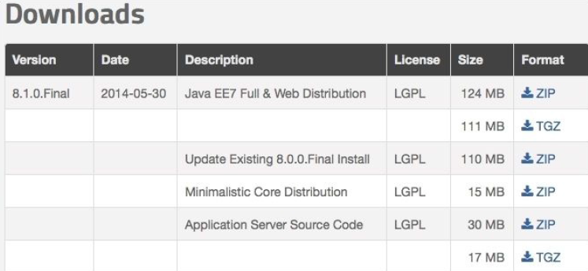
Installation
WildFly is written in Java and needs a Java Virtual Machine (JVM) in which to run, along with the standard edition Java libraries.
The WildFly application server can be downloaded for free from the WildFly site: http://www.wildfly.org/downloads/.

Slide 12
Installation (cont.)
After installing WildFly, it is wise to perform a simple startup test to validate that there are no problems with your Java configuration.
For Linux/Unix users: ./standalone.sh
For Windows users: standalone.bat

Slide 13
Installation (cont.)
PermGen has been replaced with Metaspace in Java 8. If you are using Java 8, then remove the -XX:MaxPermSize=256m property from the standalone.conf file, and replace it with -XX:MaxMetaspaceSize=256m.
This will prevent VM warnings being printed to your WildFly logs on startup.

Slide 14
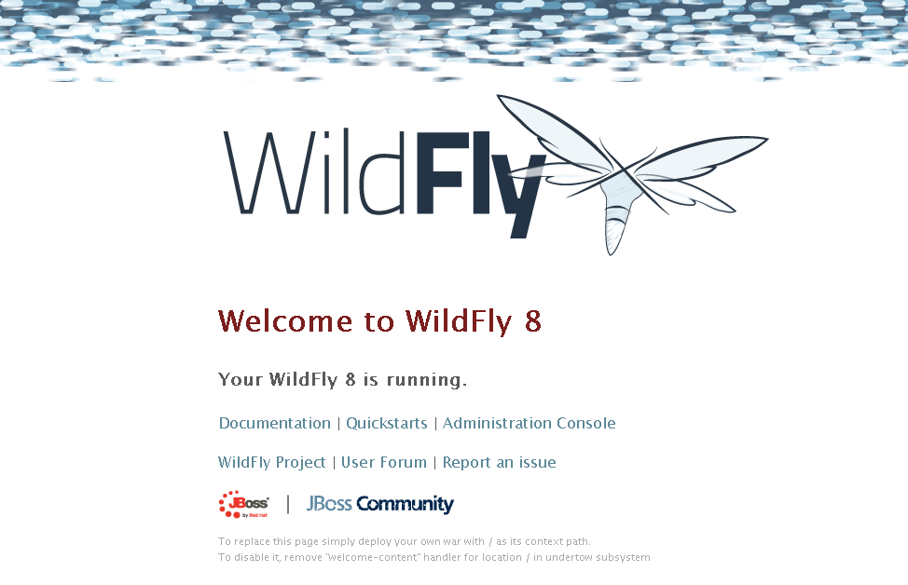
Installation (cont.)
We can verify that the server is reachable from the network by simply pointing your browser to the application server’s welcome page : http://localhost:8080 .

Slide 15
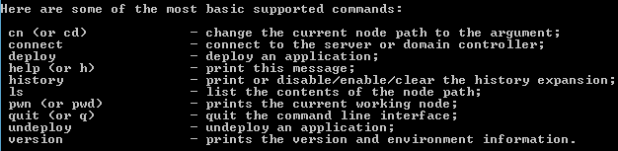


Installation (cont.)
Using jboss-cli.sh script (or jboss-cli.bat for Windows users), we can manage the application server via a shell interface.

Slide 16
Configuration
The configuration file is made up of a list of subsystems, including the application server core services and standard Java EE services.
The default configuration files are named standalone.xml, for standalone servers, and domain.xml for an application server domain.
The configuration files (standalone.xml and domain.xml) are non-static files, which means that runtime changes are persisted to them.
The WildFly 8.1.0 release provides a few variants of standalone.xml (web profile), such as standalone-full.xml (full profile), and the standalone-ha.xml (web profile with high availability).

Slide 17
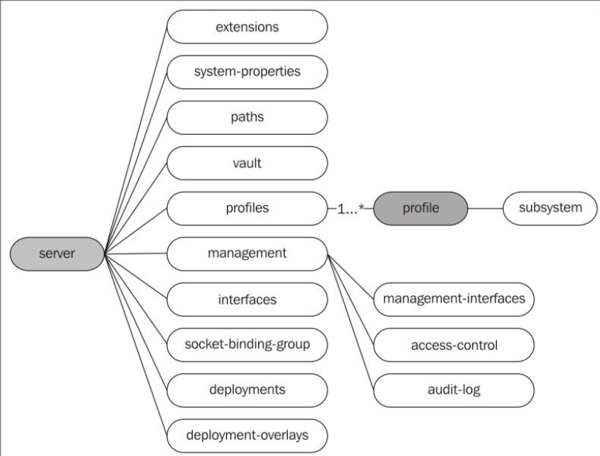
Configuration (cont.)
We can start the server with the following parameters: standalone.bat --server-config standalone-full-ha.xml

Slide 18
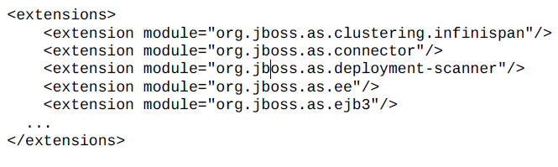
Configuration (cont.)
Extensions:
Each extension defined in the standalone.xml or domain.xml file is picked up by the WildFly class loader when we start the server, before any applications are deployed.
The static modules are stored in the JBOSS_HOME/modules folder.

Slide 19
Configuration (cont.)
Paths:
Logical names for a filesystem path can be defined using the paths element.
For a standalone server, this directory translates into JBOSS_HOME/standalone/log/mylogdir:
<paths>
<path name="log.dir" path="mylogdir" relativeto="jboss.server.log.dir"/>
</paths>

Slide 20
Configuration (cont.)
Management interfaces:
The management interfaces are configured within the management element.
This configuration is used by the CLI, the administration console, and by JMX.
<socket-binding-group name="standard-sockets" default-interface="public">
<socket-binding name="management-http" interface="management" port="9990"/>
<socket-binding name="management-https" interface="management" port="9993"/>
</socket-binding-group>

Slide 21
Configuration (cont.)
Profiles and subsystems:
A profile can be seen as a collection of subsystems, and each subsystem in turn contains a subset of functionalities added to the application server by means of extensions
The web subsystem contains the definition of a set of connectors used by the container.
When using a standalone configuration, there’s a single profile that contains the set of subsystem configurations.
Domain configuration can, on the other hand, provide multiple profiles.

Slide 22
Configuration (cont.)
Interfaces:
Interfaces define a logical name for where network interfaces/IP address or host names can be bound.
By default, the standalone application server defines two available network interfaces, the management interface and the public interface:
<interfaces>
<interface name="management">
<inet-address value="${jboss.bind.address.management:127.0.0.1}"/>
</interface>
<interface name="public">
<inet-address value="${jboss.bind.address:127.0.0.1}"/>
</interface>
</interfaces>

Slide 23
Configuration (cont.)
The socket-binding groups:
A socket-binding group defines a logical name for a socket.
Each socket-binding name can be referenced in other parts of the configuration file.
In this section, you are able to configure the network port that will be listening for incoming connections.
<socket-binding-group name="standard-sockets" default-interface="public">
<socket-binding name="management-http" interface="management" port="9990"/>
<socket-binding name="management-https" interface="management" port="9993"/>
<socket-binding name="ajp" port="8009"/>
<socket-binding name="http" port="8080"/>
<socket-binding name="https" port="8443"/>
<socket-binding name="jacorb" interface="unsecure" port="3528"/>
<socket-binding name="jacorb-ssl" interface="unsecure" port="3529"/>
<socket-binding name="txn-recovery-environment" port="4712"/>
<socket-binding name="txn-status-manager" port="4713"/>
</socket-binding-group>

Slide 24
Configuration (cont.)
System properties :
This section contains a set of system-wide properties, which can be added to the application server as part of the booting process.
By default, the system-properties entry is excluded from the configuration.
<system-properties>
<property name="myboolean" value="true"/>
</system-properties>
The property can be later retrieved on the application server using the following code:
String s = System.getProperty("myboolean");

Slide 25
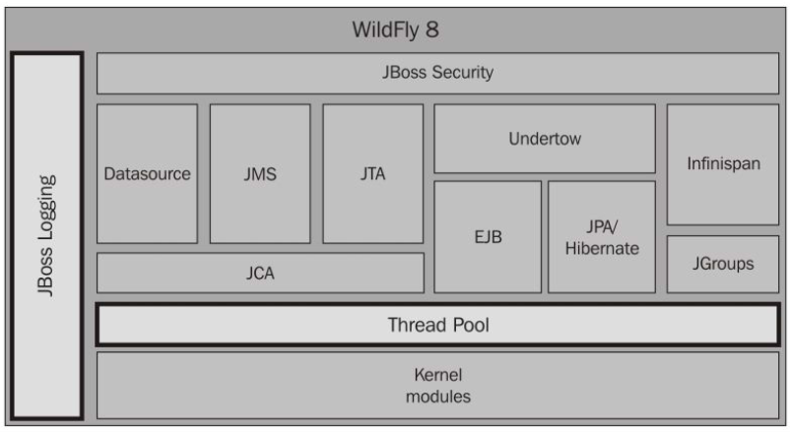
Configuration (cont.)
Deployments:
Each time a new application is deployed or undeployed, this section is updated to reflect the new application stack.
WildFly 8 subsystems:

Slide 26
Undertow Web Server
Undertow is written in Java and based on the NIO.
There are 3 core parts that make up the Undertow server:
XNIO workers:
thin abstraction layer over Java NIO, providing a channel API, management of IO and worker threads, and SSL support.
Listeners:
handle incoming connections and the underlying protocol.
Handlers:
provide the main functionality for Undertow.
define how incoming requests are handled.

Slide 27
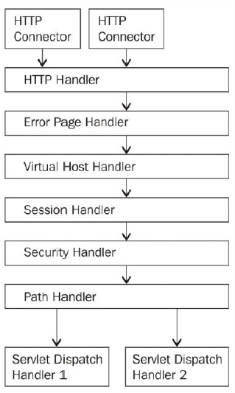
Undertow Web Server (cont.)
Bellow diagram shows how these components fit together to create the web server.

Slide 28
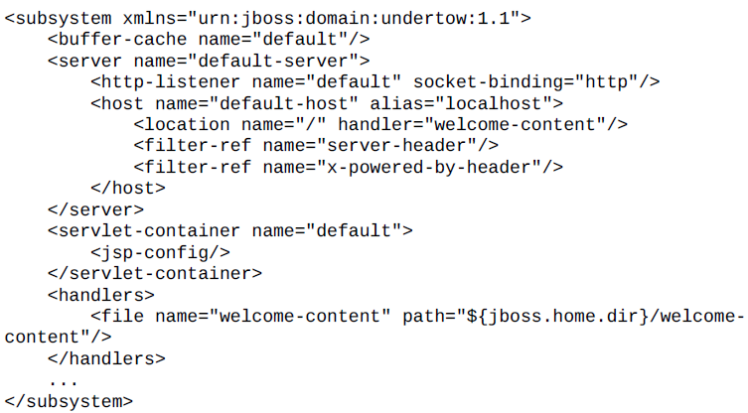
Undertow Web Server (cont.)
Undertow is configured within the Undertow subsystem found in the standalone.xml file.
Undertow is made up of listeners and handlers.

Slide 29
Domain Configuration
A domain is a group of WildFly servers managed by one of the servers.
The server managing the domain is called the domain controller.
This group is under one administration, it is the administrative unit.

Slide 30
Domain Configuration (cont.)
A domain is made up of four elements:
Domain controller:
the domain controller is the management control point of your domain.
Host controller:
coordinates the life cycle of server processes and the distribution of deployments, from the domain controller to the server instances, with the domain controller.
Process controller:
lightweight process whose primary function is to spawn server and host controller processes, and manage their input/output streams.
Application server nodes:
regular Java processes that map to instances of the application server.

Slide 31
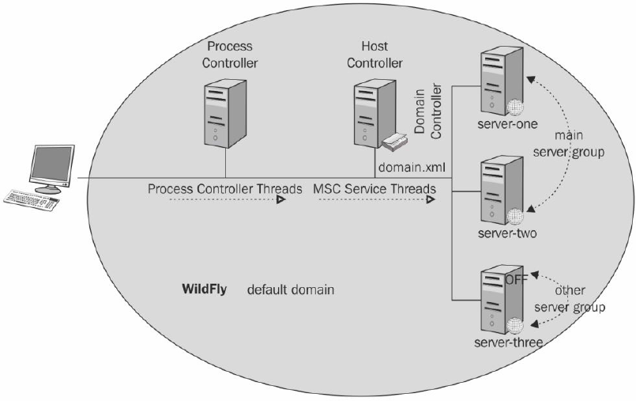
Domain Configuration (cont.)
A server group is a group of servers that have the same configuration and are managed as one.
Notes:
The default domain configuration (domain.xml) includes a basic configuration made up of the following elements:
One process controller that starts the other JVM processes
One host controller that acts as the domain controller
Three server nodes, with the first two being part of the main server group and the third one (inactive) as part of the other server group

Slide 32
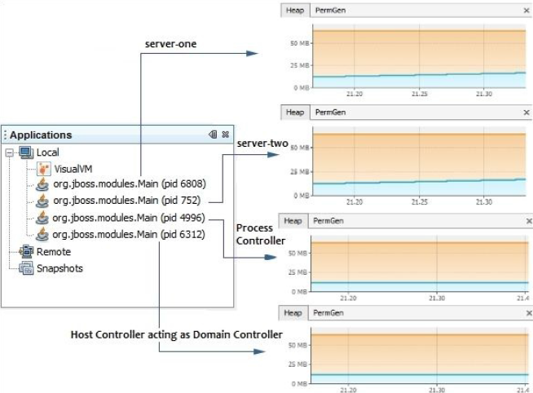
Domain Configuration (cont.)
We can see from the following screenshot that four JVM processes are spawned.
The process controller is started first, which launches the host controller process and the two server nodes.

Slide 33
Domain Configuration (cont.)
The domain configuration consists of the following 2 files from JBOSS_HOME\domain\configuration folder:
domain.xml:
defines the server groups that are part of the domain.
host.xml:
file is present on each host where the domain is installed and specifies the elements specific to the servers running on the host.

Slide 34
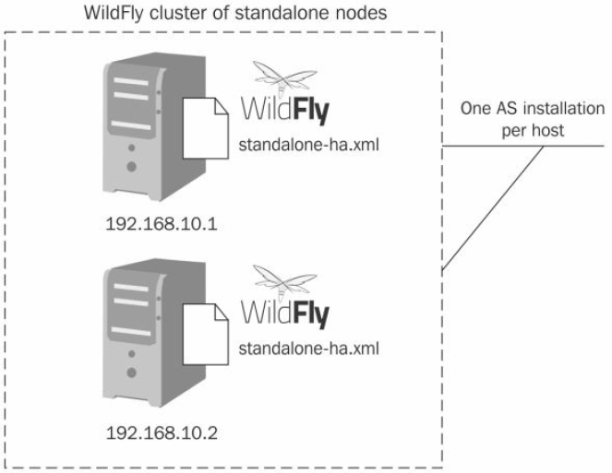
Clustering
Clustering provides provides scalability and high availability to applications.
One major benefit of using clustering is that you can spread the traffic load across several AS instances via load balancing.

Slide 35
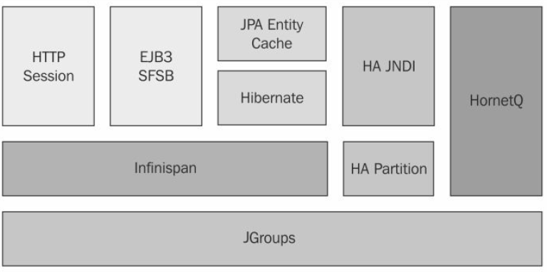
Clustering (cont.)
WildFly supports clustering out of the box.
There are several libraries that work together to provide support for clustering.
The JGroups library is core to WildFly clustering and provides the communication channels between nodes of the cluster using a multicast transmission.
Infinispan handles the replication of your application data across the cluster by means of a distributed cache.

Slide 36
Clustering (cont.)
Within the realm of JGroups, nodes are commonly referred to as members, and clusters are referred to as groups.
A node is a process running on a host.
JGroups keeps track of all processes within a group.
When a node joins a group, the system sends a message to all existing members of that group.
When a node leaves or crashes, all the other nodes of that group are notified.

Slide 37
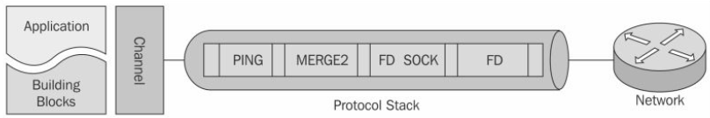
Clustering (cont.)
A JGroups process broadly consists of three parts:
A Channel is a simple socket-like interface used by application programmers to build reliable group communication applications.
The Building Blocks collectively form an abstraction interface layered on top of channels, which can be used instead of channels whenever a higher level interface is required.
The Protocol Stack contains a number of protocol layers in a bidirectional list. A layer does not necessarily correspond to a transport protocol

Slide 38
Conclusions
Java EE7 Certified
High Performance Web Server
Port Reduction
Clustering
CLI Improvements

Slide 39

Bibliography
https://en.wikipedia.org/wiki/WildFly
Packt Pub – WildFly Configuration, Deployment and Configuration – Second Edition

